Slide 1

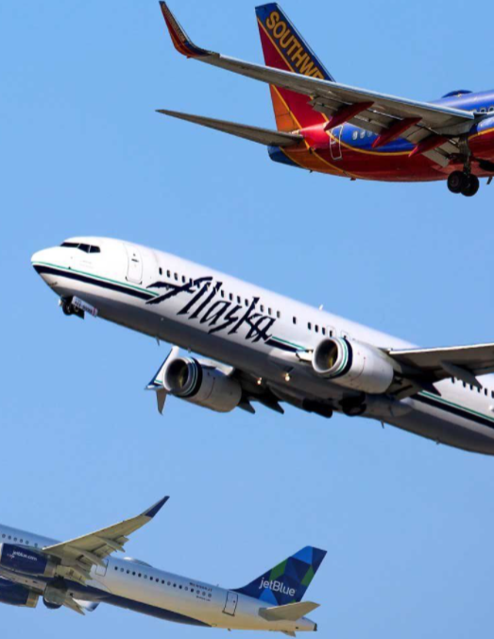
Amanda Xiong Kelly Spilman Tamilselvan Tamilmani
AIRLINE DATA SURVEY ANALYSIS
SOUTHEAST AIRLINE CO.

Slide 2
Content
Southeast Airlines Co. Overview
Data Identification
Business Questions
Descriptive Analysis/Visual
Modeling Technique
Answers & Recommendations

Slide 3
Airline Industry Analysis
Strengths
High Income
Growing Tourism Industry
Continued Growth
Safety and Speed
Weaknesses
Slow Rate of Infrastructure
High Spoilage Rate
Huge Investments
Competitive Market

Slide 4

Business Questions
Original questions:
Based on satisfaction, which airlines are performing well, and which are performing poorly?
How does class affect customer satisfaction based on age group?
Could eating and drinking at the airport before a flight affect satisfaction?
What elements contribute to the highest satisfaction score?
What times of operation are critical in affecting the satisfaction scores?
New questions from data:
How does Southeast Airlines Co. perform on satisfaction among customers that have never flown before?
How does Southeast Airlines Co. perform based on type of travel?

Slide 5
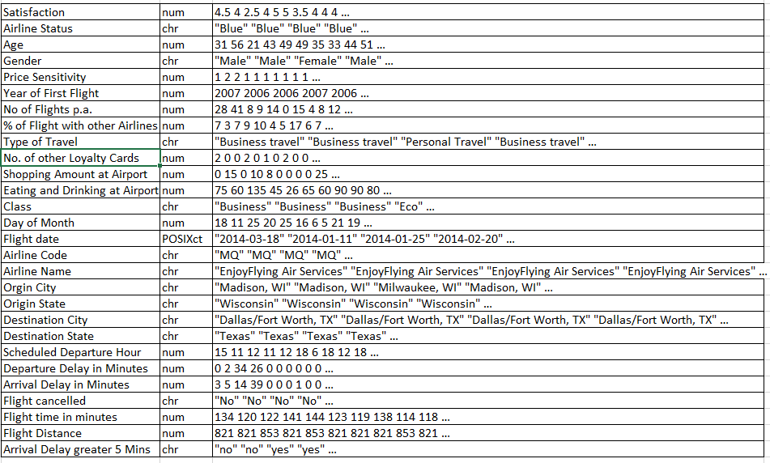
Data Identification The Airline Industry Customer Experience Benchmarks have been identified: * 28 variables * 15 are numerical * 12 are categorical * 1 date

Slide 6
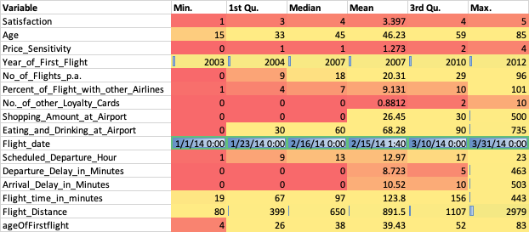
Descriptive Analysis

Slide 7
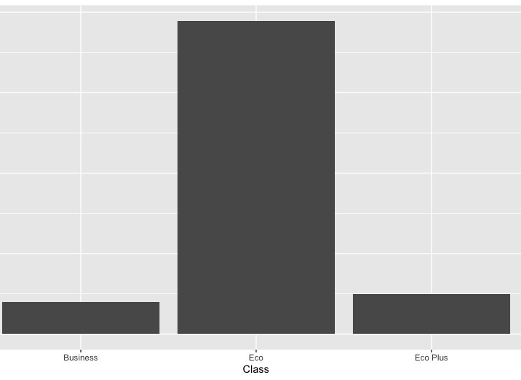
Visuals
People travelling in Economy class

Slide 8
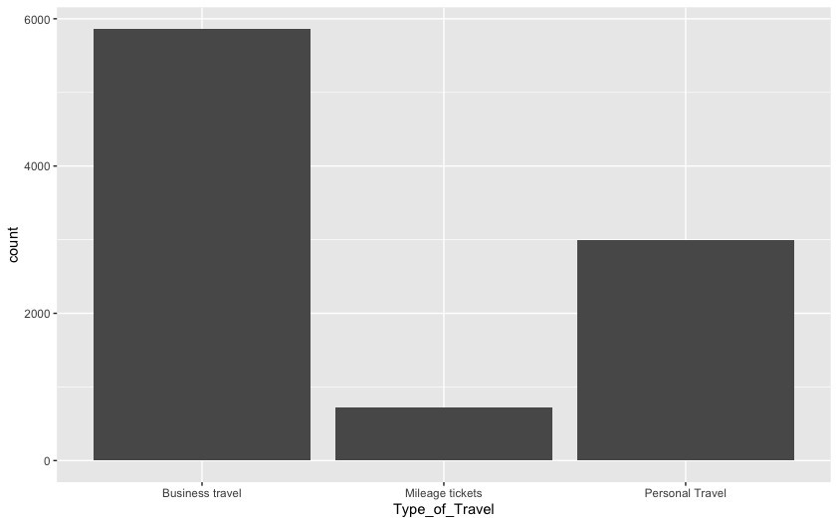
Visuals
Southeast Travelers

Slide 9
Visuals
Southeast Travelers

Slide 10
Modeling Technique: Linear Model
We filtered for Significant Variables
Did a Multi Collinearity Check and dropped conflicting ones
Did Moderating Effect Analysis and selected additional variables
Final Formula , we got a 58.56% accuracy for LM when we did a 2/3 split test,
r-squared was 43. The final r-squared was 45.68
"Satisfaction ~ Airline_Status + Gender + Age + No_of_Flights_p.a. + Eating_and_Drinking_at_Airport + Class + Scheduled_Departure_Hour + Flight_time_in_minutes + Airline_Status:Type_of_Travel + Airline_Status:Arrival_Delay_greater_5_Mins + Age:No._of_other_Loyalty_Cards + Departure_Delay_in_Minutes:Flight_time_in_minutes + Age:Percent_of_Flight_with_other_Airlines”

Slide 11
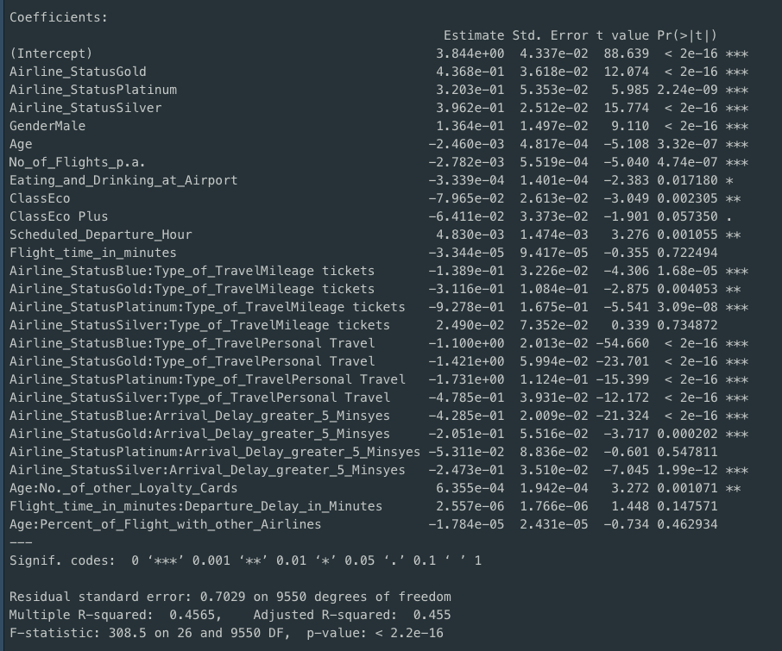
Modeling Technique: Linear Model

Slide 12
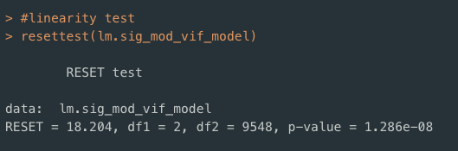
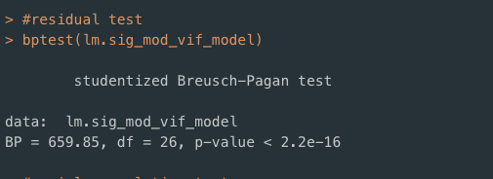
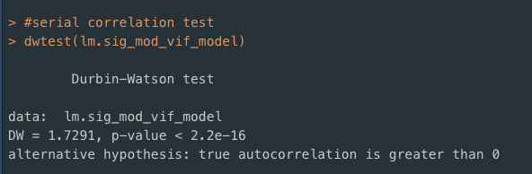
Linear Model - Analysis

Slide 13
Modeling Technique: Association Rules
Frequency Plot

Slide 14
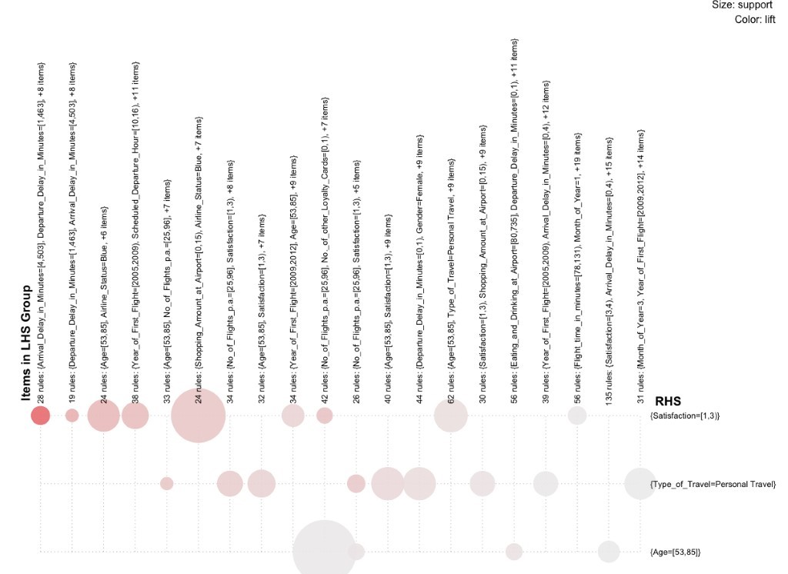
Modeling Technique: Association Rules
We did an association rule mining
And filtered out rules below lift of 2.5
Arrived at 827 Interesting rules

Slide 15
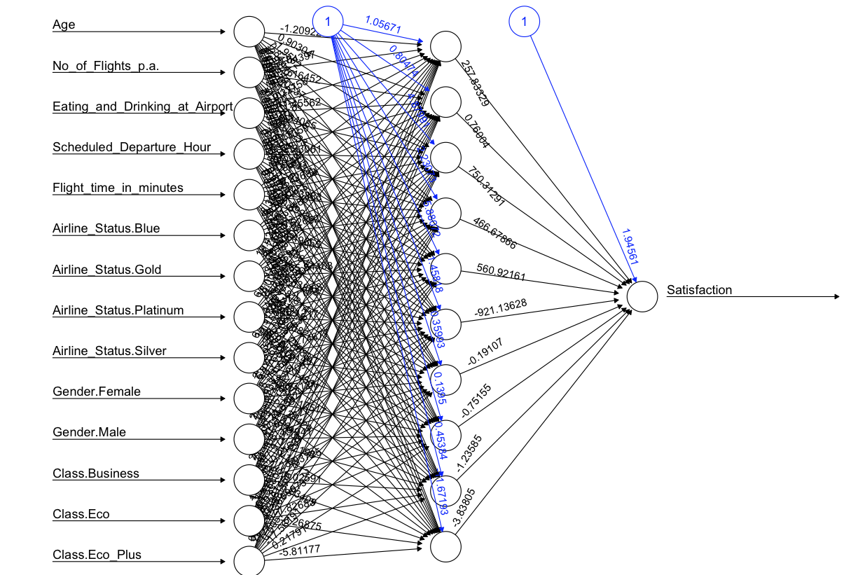
Modeling Technique: Neural Net
We finally ran a neural net with the significant Variables we found in Linear Modeling
Which gave an accuracy of 72%

Slide 16
Answers to questions
#1 – all airline companies’ mean satisfaction score ranged between 3.30 and 3.53
#2 – Class and Age together did not significantly affected the satisfaction scores
# 3 – Slight trend upward in satisfaction scores for those customers with a quantity of 200 or more
Notes:
We cannot confirm nor deny Q1 – Q3
#1 Based on Satisfaction, which airlines are performing well, and which are performing poorly?
All airlines average scores were within 0.24 of each other; therefore, no significant recommendations could be generated from this question.
#2 How does Airline Class affect customer satisfaction based on age group?
It was determined that Class and Age together did not significantly affected the satisfaction scores for Southeast Airlines. However, separately class groups economy and economy plus along with age did prove to be significant.
#3 Could eating and drinking at the airport before a flight affect the satisfaction?
The data showed that eating and drinking at the Airport was slightly significant (P-value- 0.013149)

Slide 17
Answers to questions
# 4 – Scheduled_Departure_Hour had lower satisfaction scores of 2.5 at 3 am and 2 pm
#5 – elements that contributed to satisfaction score:
Age
Airline_Status
Arrival_Delay_greater_5_minutes
Type_of_TravelMileage tickets
Type_of_TravelPersonal Travel
GenderMale
No_of_Flight_p.a
Age:No_of_Loyalty_Cards
ClassEco
Scheduled_Departure_Hour
Notes:
#4 What times of operation are critical in affecting Satisfactiontion score?
The data showed that Scheduled_Depature_Hour had lower satisfaction scores of 2.5 or lower at two critical times 3:00 A.M. and 2:00 P.M.
# 5 What elements contribute to the highest Satisfaction Scores?
Elements that contributed are as followed

Slide 18
Answers to questions
#6 – 1st time flyers with a mean over all score 3.45
#7 – 1st quarter for 2014
61% were business travelers
7% were milage ticket travelers
32% were personal ticket travelers
Notes:
#6 How does Southeast Airlines Co. perform Satisfactiont among customers that have never flown before?
Southeast had 471 1st time flyers submit satisfaction ratings with a mean over all score of 3.45.
The mean of the satisfaction scores among 1st time flyer goes up with age.
#7 How does Southeast Airline Co. perform based on type of Travel?
Of the 9577 travelers on Southeast Airlines during the 1st quarter of 2014 61% were business travelers with a mean satisfaction score of 3.78. 7% were mileage ticket travelers with a mean satisfaction score of 3.56 and Personal travel tickets made up the final 32% with a mean satisfaction score of 2.59.

Slide 19
Recommendations
Create incentives for the age population of 53 and older
1
Critical Times to consider - 3 AM and 2 PM
2
Make subsequent flight experiences better for customers
3
Find a way to identify personal airline travelers and provide additional benefits
4
Avoid Arrival Delays
5
Notes:
Create incentives for the age population of 53 and older.
Southeast had better satisfaction scores from the same age group who also participated in multiple loyalty card programs.
Make delayed flight decisions based on arrival times.
The data provided insight into certain timeframes in which customers are more likely to give lower satisfaction scores based on arrival delays at 3:00 A.M. and at 2:00 P.M.
Make subsequent flight experiences better for customers.
The satisfaction scores for subsequent flights decreases after the 1st initial Flight. Implement a better loyalty program for frequent flyers, this will provide incentives for customers to come back for return flights.
Find a way to identify personal airline travelers and provide additional benefits.
61% of the customers that are flying on your airline are business customers who have given a mean satisfaction score of 3.78.
Try to avoid Arrival Delays
From our significant variables, we can see that the arrival delay contributes more to the Satisfaction, so even if we depart late, try to make up during the flight and arrive on time.

Slide 20
Thank you
Questions?

